Slide 1
SE-3002 Software Quality Engineering
Lecture 1-Chapter 1
Overview and Basics
Alina Arshad
alina.arshad@nu.edu.pk

Slide 2
Tentative Mark Distribution and Grading Policy
Assignments/Class Participation: 6 %
Mid Exams: 25 %
Final: 50%
Presentations + Projects: 10%
Quiz’s: 9%

Slide 3
Course Ethics
Projects/Assignments
Deadlines are always final
No credit for late submissions
Project Proposal Submission : 3rd Week
Project Presentation : Last week
Quizzes
Announced
Unannounced

Slide 4
Pre-requisites/Knowledge assumed
Software Engineering
Software Analysis and Design
Programming language concepts
Data structure concepts
Database system concepts

Slide 5
Course Outline
Basic concept of software quality and Importance of software quality
Software Quality Standards e.g. ISO 9126
Software Quality attributes and characteristics
Software Quality Assurance (SQA) techniques
Software Quality Control
Static Testing Techniques types
Dynamic Testing levels
Software Quality Measurement Model

Slide 6
Major Topics of the course
Software Quality, Software Quality Attributes, Quality Engineering,
Testing Concepts, Issues, Software testing lifecycle. Testing Scopes, Testing Approaches,
Requirement of software test planning, Testing documentation, Software testing techniques, Testing philosophies
Testing strategies, Software inspections, Software reviews, Inspection checks and metrics,
From functional to system aspects of testing, System testing, Scenarios development, Use-cases for testing, Specification-based testing, Open issues on software testing,
Quality Models, Models for quality assessment, Product quality metrics, Quality Measurements, Quality improvement

Slide 7
How this course will run
The course is divided into four parts
Part I (Chapters 1-5). Overview and Basics:
Part II (Chapters 6-12). Software Testing
Part III (Chapters 13-17). Other Quality Assurance Techniques
Part IV (Chapters 18-22). Quantifiable Quality Improvement

Slide 8
Software quality engineering
PART I
Overview and Basics
What is Quality?, Quality Assurance, QA in Context, Quality Engineering and Quality Challenge

Slide 9
Software quality engineering
PART II
Software Testing:
Models & techniques, management, automation, and integration

Slide 10
Software quality engineering
PART III
Other Quality Assurance Techniques
Defect prevention, process improvement, inspection, formal verification, fault tolerance, accident prevention, and safety assurance.

Slide 11
Software quality engineering
PART IV
Quantifiable Quality Improvement
Analysis and feedback, measurements and models, defect analysis, risk identification, and software reliability engineering.

Slide 12
Course Material
You will have Presentations of each topic and reference books in PDF format will be available on GCR.
Text Books
Software Quality Engineering Testing, Quality Assurance, and Quantifiable Improvement, Jeff Tian, Wiley, 2005
Software Testing, Principles and Practices, 2nd edition, Naresh Chauhan, Oxford publisher, 2016
Reference Books
Software Quality Engineering, A Practitioner’s Approach, Witold Suryn, Wiley, 2014

Slide 13
Overview of SQE
To discover and learn various concepts and techniques related to software quality assurance.
Comprehension of why do we have to engineer quality into software/static and dynamic testing techniques for Quality Control (QC) / Software Quality Assurance Plan (SQAP) and Software Quality Measurement using Models (QMM).
To learn to apply these techniques.
To develop critical thinking skills.
Defining quality assurance plans.
Applying quality assurance tools & techniques, etc.

Slide 14
What is Software?
Software – IEEE definition :
computer programs
procedures
possibly associated documentation
data pertaining to the operation of computer system.
All four components are needed in order to assure the quality of the software development process.

Slide 15
Quality - Definitions
Quality is the degree to which an object satisfies a specified set of attributes or requirements.
Attributes and degree of conformance.
“How good or bad something is” Merriam-Webster
“Level of excellence” Wiktionary

Slide 16
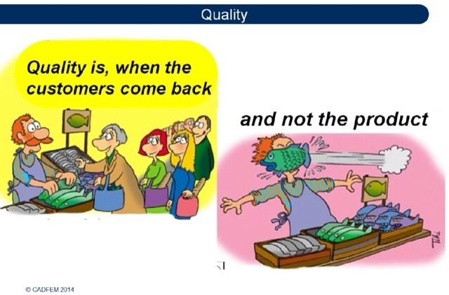
Quality – Simple sense

Slide 17
What is Quality Assurance
It is a system of activities designed to ensure production that meets pre-established requirements and standards.
It monitors and tries to improve the development process from the beginning of the project.
It makes sure that the project will be completed based on the previously agreed
specifications
standards and
functionality required
without defects and possible problems

Slide 18
What is Software Quality?
No commonly agreed definition
IEEE definition
“The degree to which a system, component, or process meets specified requirements (Philip Crosby)”
“The degree to which a system, component, or process meets customer or user needs or expectations (Joseph M. Juran)”

Slide 19
What is Software Quality?
Pressman believes that Software quality is:
Software Quality is conformance to:
Explicitly stated functional and performance requirements,
Explicitly documented development standards,
Implicit characteristics that are expected of all professionally developed software.

Slide 20
People’s Quality Expectations
In general, people’s quality expectations for software systems they use and rely upon are two-fold:
The software systems must do what they are supposed to do. In other words, they must do the right things.
They must perform these specific tasks correctly or satisfactorily. In other words, they must do the things right.

Slide 21
Why should we strive for Quality?
Historical software failures
First launch of space shuttle/Airbus 320/Y2K/AT&T telephone network etc.
Have you ever strived for Quality?
How do you perceive Quality?
Who should be responsible for the Quality?
Quality is everybody’s job, but because it is everybody’s job, it can become nobody’s job
A study commissioned by the National Institute of Standards and Technology found that software bugs cost the U.S. economy about $59.5 billion per year

Slide 22
Reasons Software Quality is Important
Safety
Cost
Customer satisfaction
Future value

Slide 23
Any question????

